Slide 1
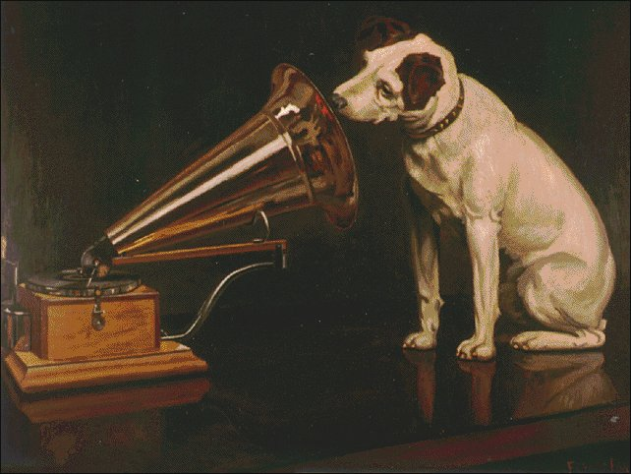
Hearing God
⁴⁷ He who belongs to God hears what God says. The reason you do not hear is that you do not belong to God.”

Slide 2
Acts 15:36-16:15

Slide 3
³⁶ And after some days Paul said to Barnabas, “Let us return and visit the brothers in every city where we proclaimed the word of the Lord, and see how they are.” ³⁷ Now Barnabas wanted to take with them John called Mark. ³⁸ But Paul thought best not to take with them one who had withdrawn from them in Pamphylia and had not gone with them to the work. ³⁹ And there arose a sharp disagreement, so that they separated from each other. Barnabas took Mark with him and sailed away to Cyprus, ⁴⁰ but Paul chose Silas and departed, having been commended by the brothers to the grace of the Lord. ⁴¹ And he went through Syria and Cilicia, strengthening the churches.

Slide 4
16 Paul came also to Derbe and to Lystra. A disciple was there, named Timothy, the son of a Jewish woman who was a believer, but his father was a Greek. ² He was well spoken of by the brothers at Lystra and Iconium. ³ Paul wanted Timothy to accompany him, and he took him and circumcised him because of the Jews who were in those places, for they all knew that his father was a Greek. ⁴ As they went on their way through the cities, they delivered to them for observance the decisions that had been reached by the apostles and elders who were in Jerusalem. ⁵ So the churches were strengthened in the faith, and they increased in numbers daily.

Slide 5
⁶ And they went through the region of Phrygia and Galatia, having been forbidden by the Holy Spirit to speak the word in Asia. ⁷ And when they had come up to Mysia, they attempted to go into Bithynia, but the Spirit of Jesus did not allow them. ⁸ So, passing by Mysia, they went down to Troas. ⁹ And a vision appeared to Paul in the night: a man of Macedonia was standing there, urging him and saying, “Come over to Macedonia and help us.” ¹⁰ And when Paul had seen the vision, immediately we sought to go on into Macedonia, concluding that God had called us to preach the gospel to them.

Slide 6
¹¹ So, setting sail from Troas, we made a direct voyage to Samothrace, and the following day to Neapolis, ¹² and from there to Philippi, which is a leading city of the district of Macedonia and a Roman colony. We remained in this city some days. ¹³ And on the Sabbath day we went outside the gate to the riverside, where we supposed there was a place of prayer, and we sat down and spoke to the women who had come together. ¹⁴ One who heard us was a woman named Lydia, from the city of Thyatira, a seller of purple goods, who was a worshiper of God. The Lord opened her heart to pay attention to what was said by Paul. ¹⁵ And after she was baptized, and her household as well, she urged us, saying, “If you have judged me to be faithful to the Lord, come to my house and stay.” And she prevailed upon us.

Slide 7
Knowing and Doing the Will of God
In some matters, it’s easy to know the will of God
Believe in Jesus
Submit to Christ as Lord
In love, obey God’s commandments
In other areas, it’s not so easy so we have to rely on prayer; acting in faith; wisdom; discernment
It all begins with handing it over to God. If Jesus is Lord,
everything I have and everything I’m responsible for, belongs to Jesus
Therefore every major decision is a Kingdom of God decision.
Seeking God’s Will in Mission

Slide 8
Knowing and Doing the Will of God in Mission
The Lord rarely lays out a full plan for us
Sometimes we’re left wondering
Sometimes we have to ‘feel our way’
Sometimes He will give us a clear direction (but only up to a point)
Never be so committed to our plans that we’re closed to re-direction
Never will our walk with God be characterised by inactivity.

Slide 9
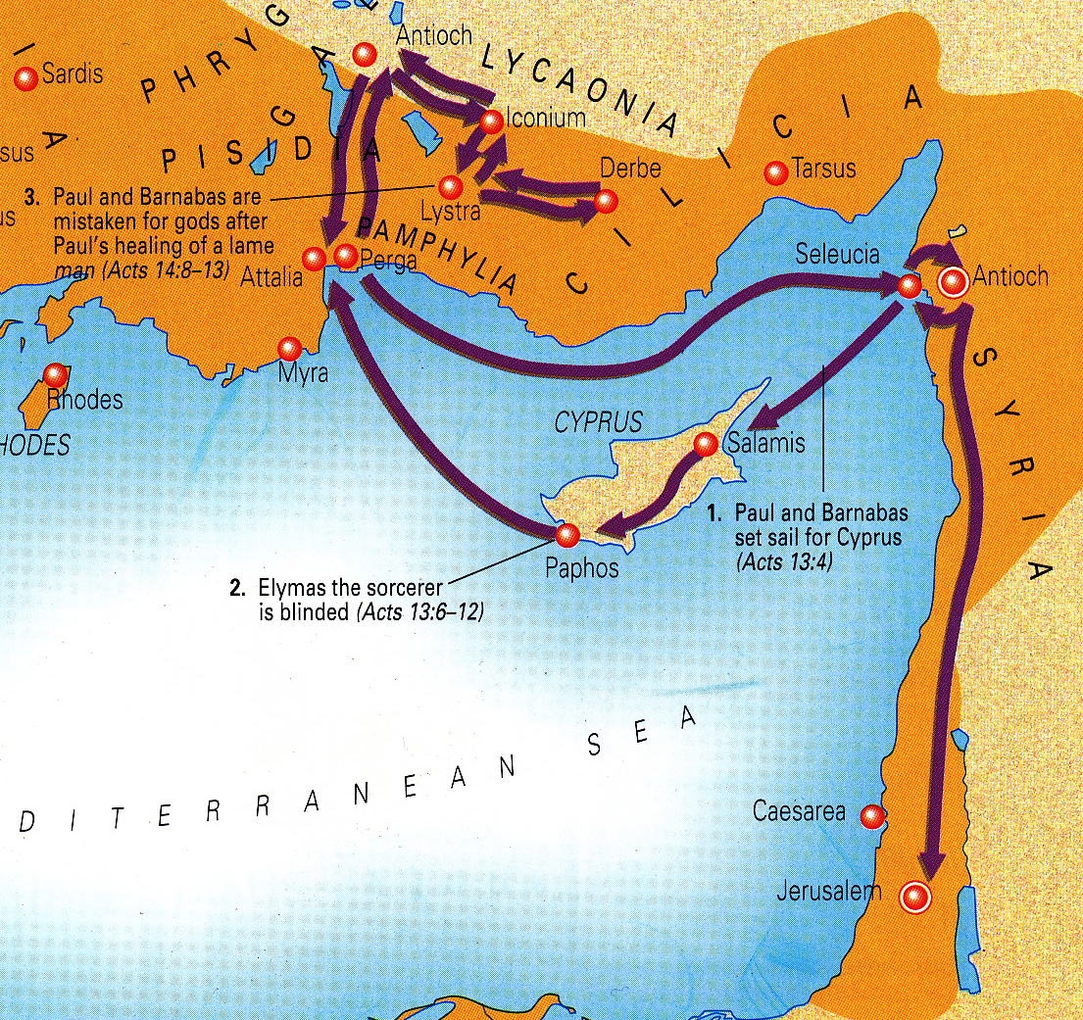

Slide 10
Knowing and Doing the Will of God in Mission
The Lord rarely lays out a full plan for us
Sometimes we’re left wondering
A painful split in the team – disagreement between disciples
Sometimes we have to ‘feel our way’
In the absence of a clear direction from God, they did what they thought best
Sometimes He will give us a clear direction (but only up to a point)
Never be so committed to our plans that we’re closed to re-direction
A new partnership in mission
Never will our walk with God be characterised by inactivity.
Let’s go back and see how the churches are going....

Slide 11
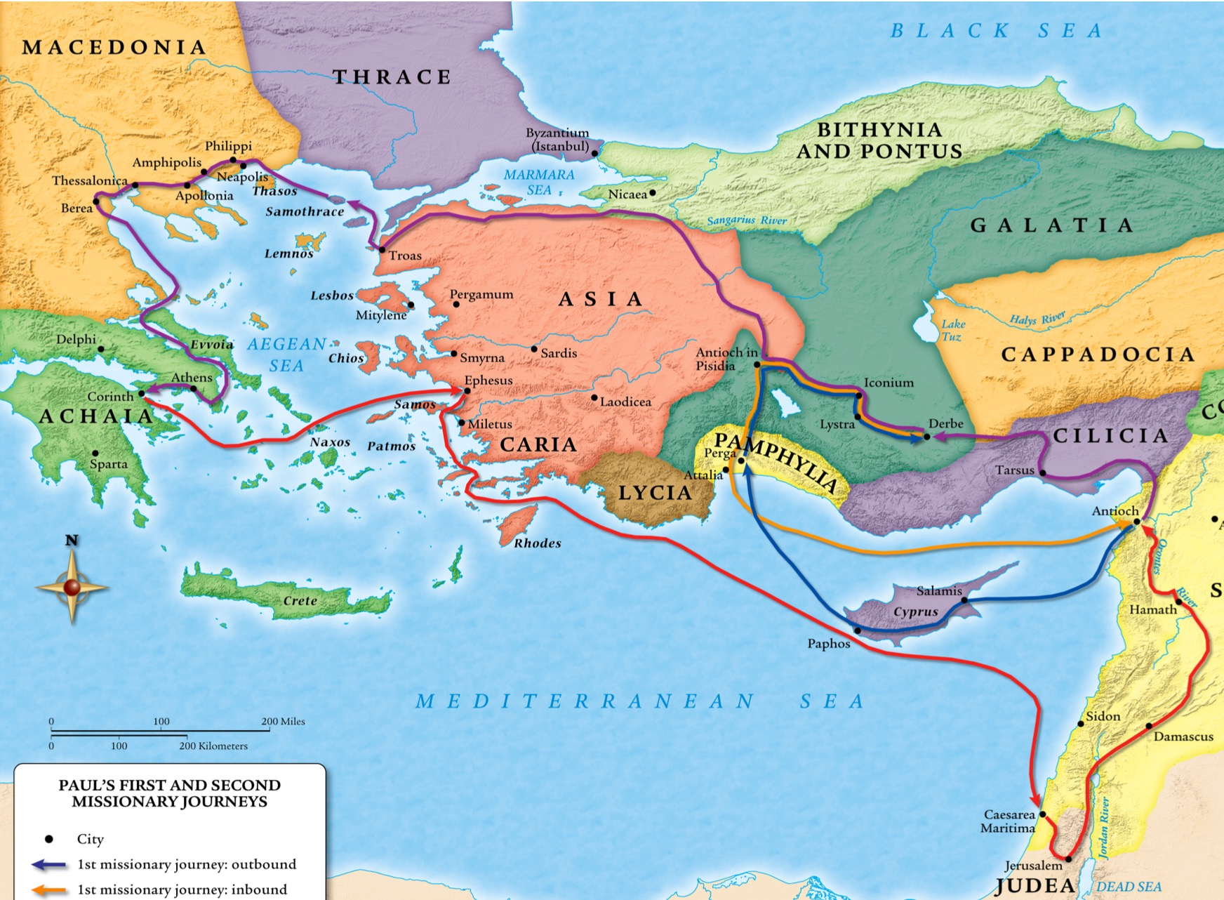

Slide 12
Knowing and Doing the Will of God in Mission
The Lord rarely lays out a full plan for us
Sometimes we’re left wondering
A painful split in the team – disagreement between disciples
Sometimes we have to ‘feel our way’
In the absence of a clear direction from God, they did what they thought best
Timothy was well respected – “Come with us on mission”
Sometimes He will give us a clear direction (but only up to a point)
Never be so committed to our plans that we’re closed to re-direction
A new partnership in mission
Never will our walk with God be characterised by inactivity.
Let’s go back and see how the churches are going....

Slide 14
Knowing and Doing the Will of God in Mission
The Lord rarely lays out a full plan for us
Sometimes we’re left wondering
A painful split in the team – disagreement between disciples
Sometimes we have to ‘feel our way’
In the absence of a clear direction from God, they did what they thought best
Timothy was well respected – “Come with us on mission”
God said “STOP”. I guess we go this way now....
Sometimes He will give us a clear direction (but only up to a point)
Holy Spirit says “STOP – I have a new direction...”
Vision – “Come to Macedonia”
Never be so committed to our plans that we’re closed to re-direction
A new partnership in mission
A new direction in mission
Never will our walk with God be characterised by inactivity.
Let’s go back and see how the churches are going....

